Slide 1
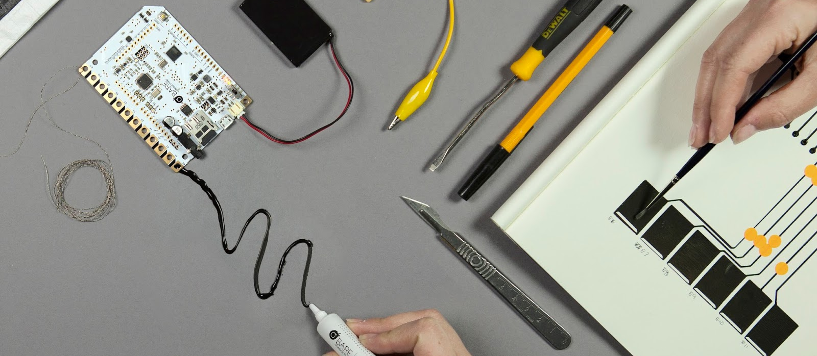
Interactive Wall
Project Exprerience 2.2 International

Slide 2
1
Introduction
2
Team-members
3
Task
4
Problem Statement
5
Execution
6
Interactive Wall
Difficulties

Slide 3
7
Result
8
Future improvements
9
Question

Slide 4
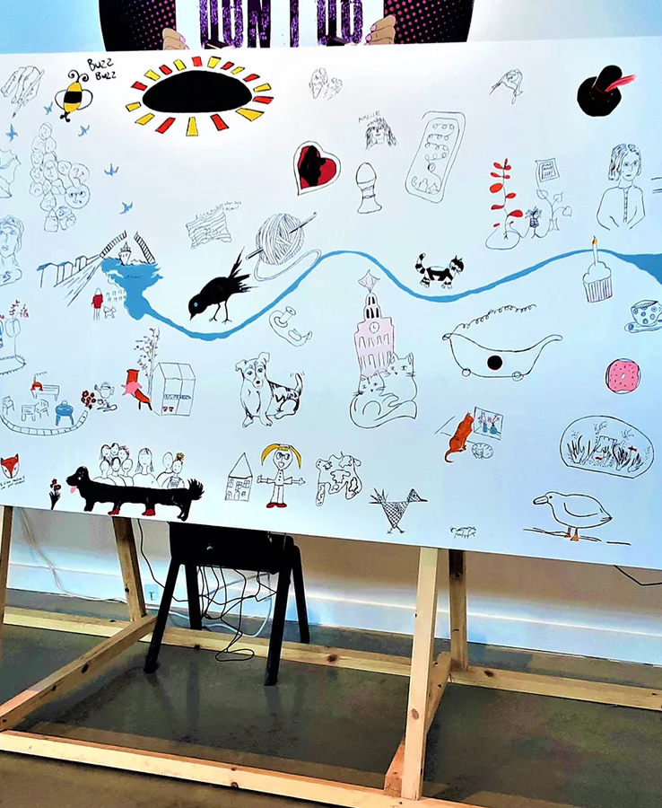
1. Introduction
What is the project?
-Interactive Board
-Touch as input
-No fysical buttons
-Seemless experience
-Class (Toddlers)
Introduction

Slide 5
2. Team-Members
Who are we?
Luca Declerck
Scrum-master
Hardware
William Rogov
Board assembly
Debugging
Documentation
Team- Members

Slide 6
2. Team-Members
Who are we?
Xander Desmedt
Software
Hardware
Simon Haessaert
Team- Members

Slide 7
3. Task
What outcome do we want?
A interactive Wall with Bare Conductive
- Touchboard kit
- 2x1 meters
- For toddlers
-€ 212,09
2. A interactive Wall with ESP32
- Reverse engineer
- Replicate
- Budget
- € 14,95
Tasl

Slide 8

4. Problem-statement
1° ”Producing a interactive Wall with the Touch board kit from Bare Conductive.”
2° “Reverse-engineer the Touch board Kit to reproduce it with a cheaper alternative”
Problem-statement

Slide 9
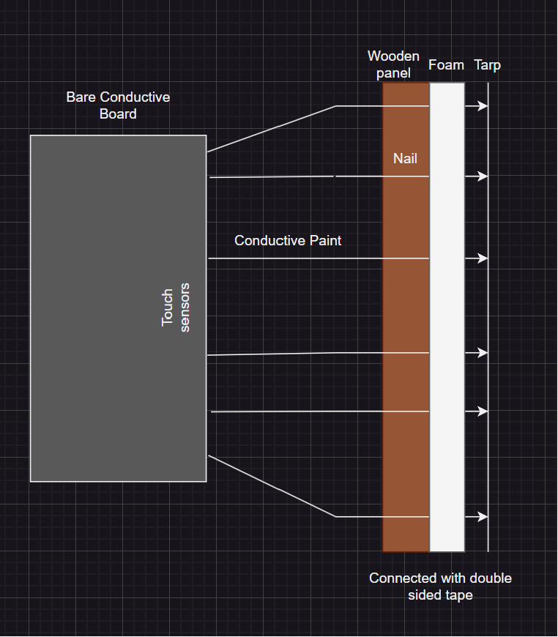
4. Execution
Production of the first board
-Farm (9 different animals) made of tarp
-Conductive Paint
-Screws thru the board (coper wires)
Execution

Slide 10
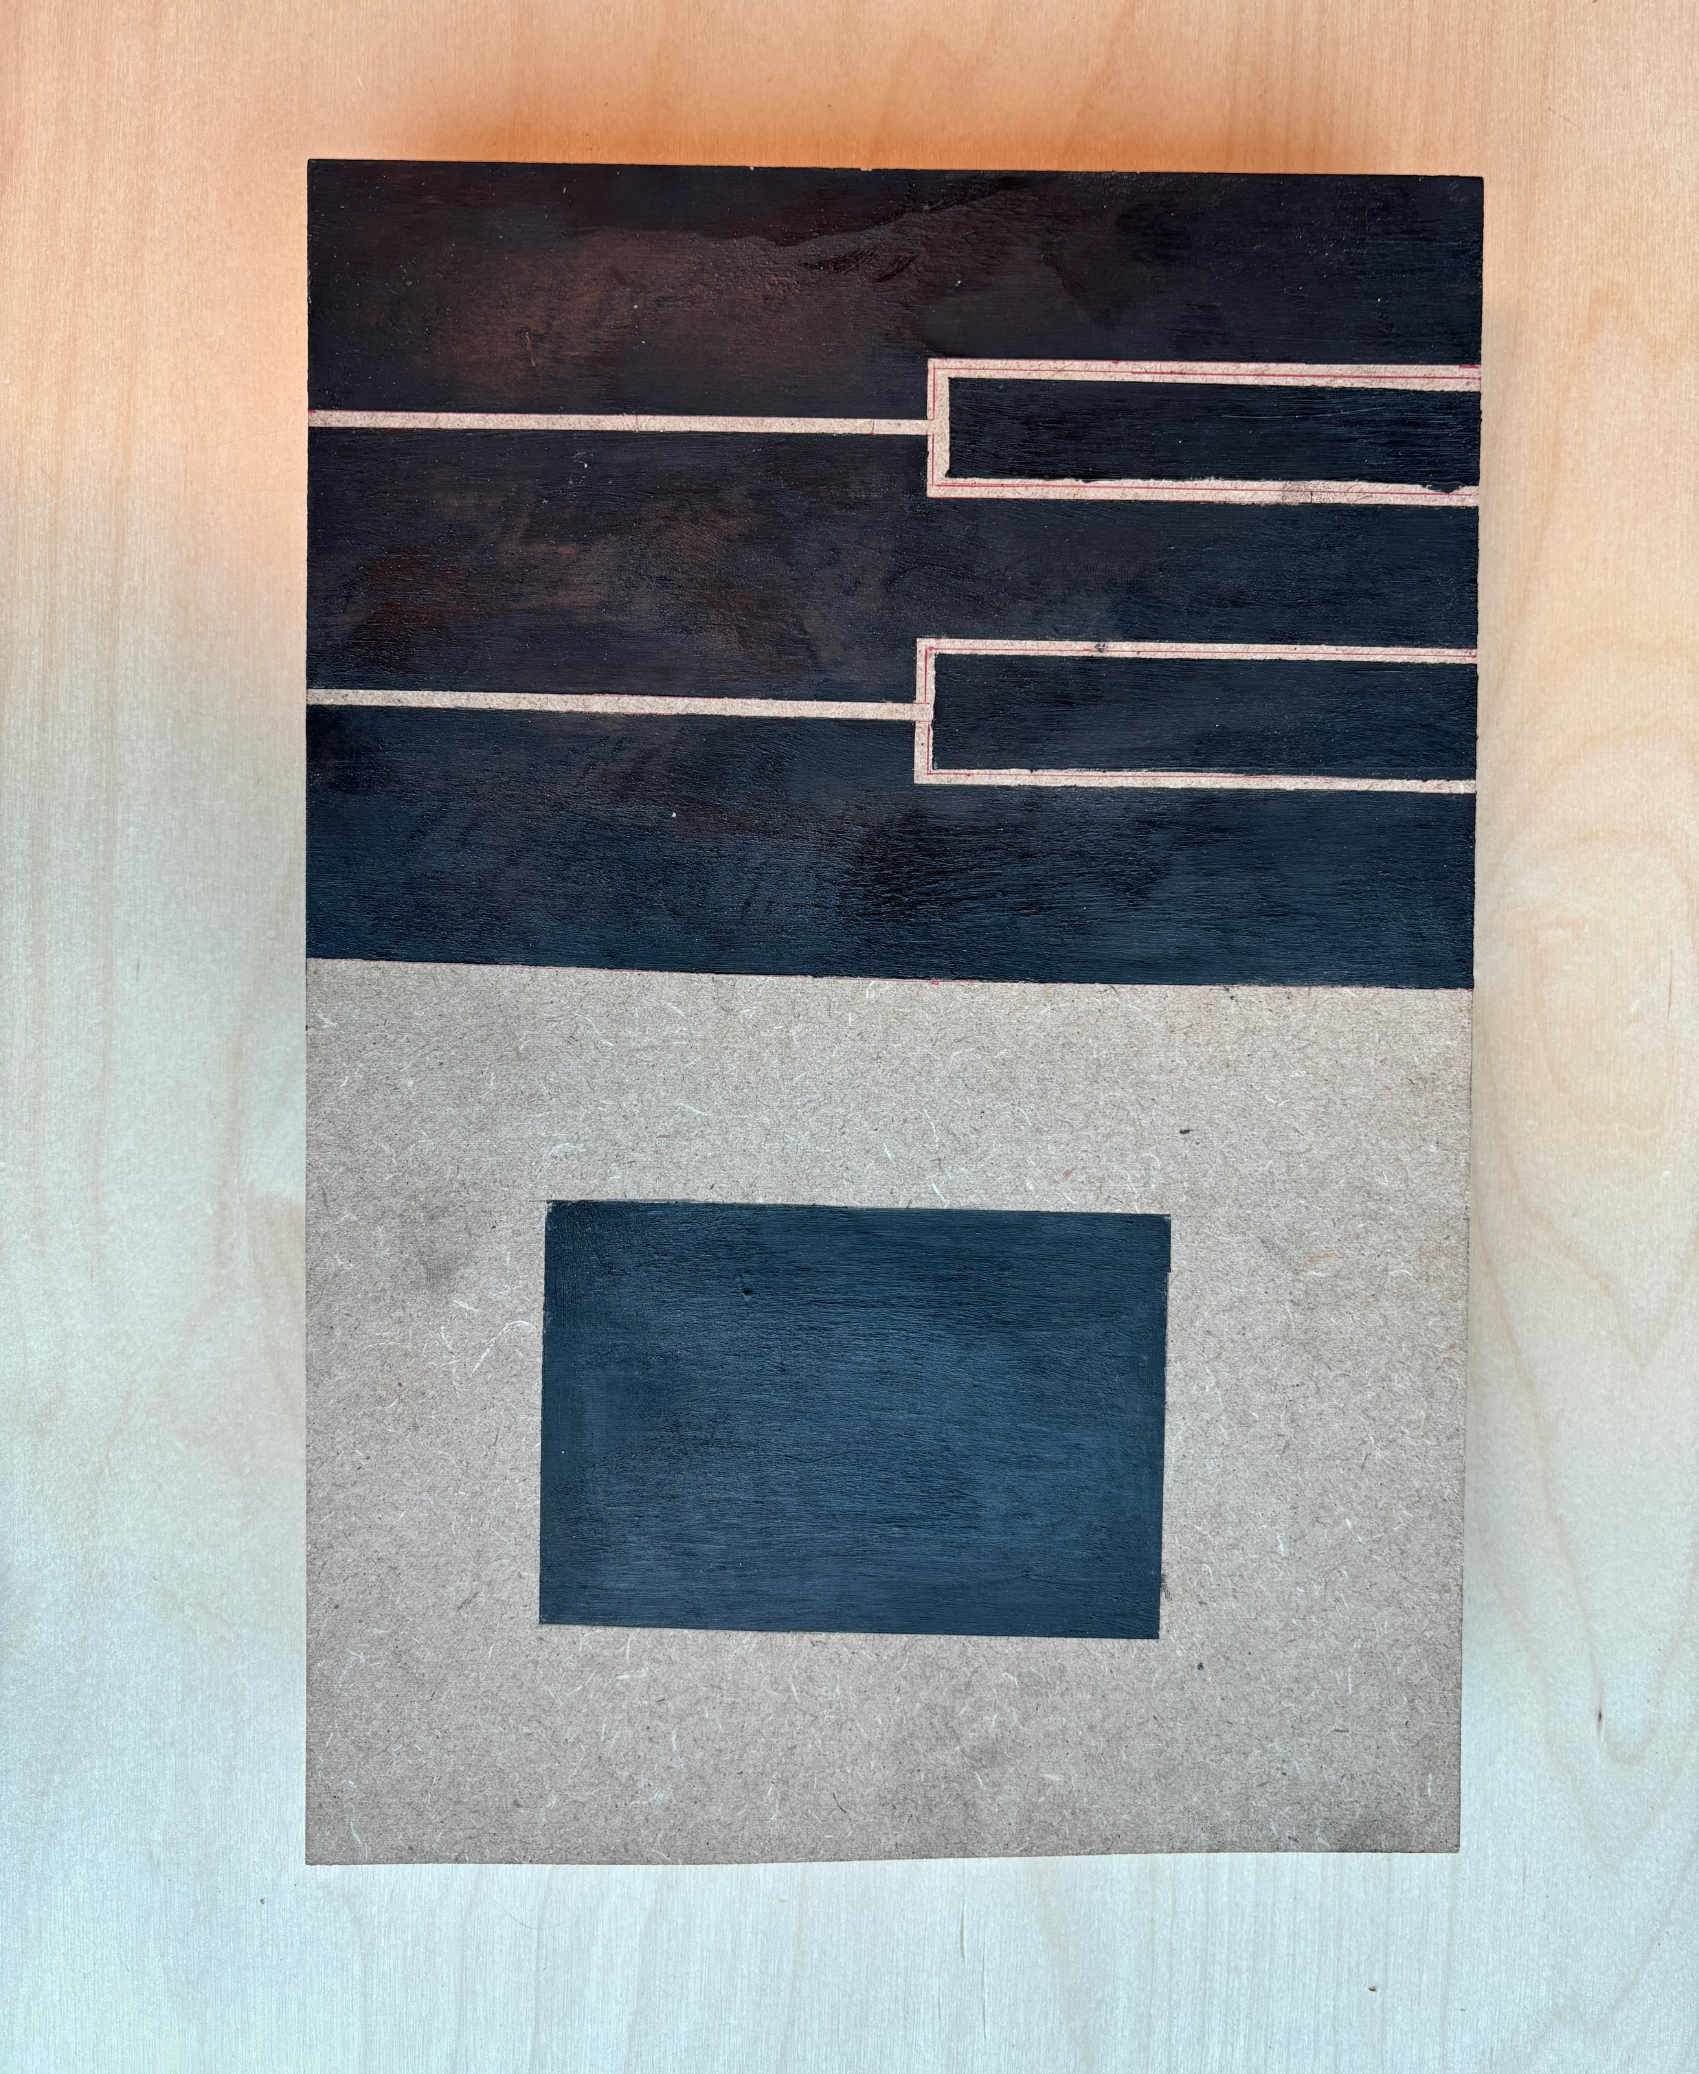
4. Execution
Production of the second board
-5 piano keys
- Pad (change sounds)
-Screws
Execution

Slide 11

5. Diffeculties
Problems that we faced
- Bare Conductive -> sensitive to change
-Few documentation (reverse-engineering)
-Trail and error
-Late delivery of materials
Diffeculties

Slide 12
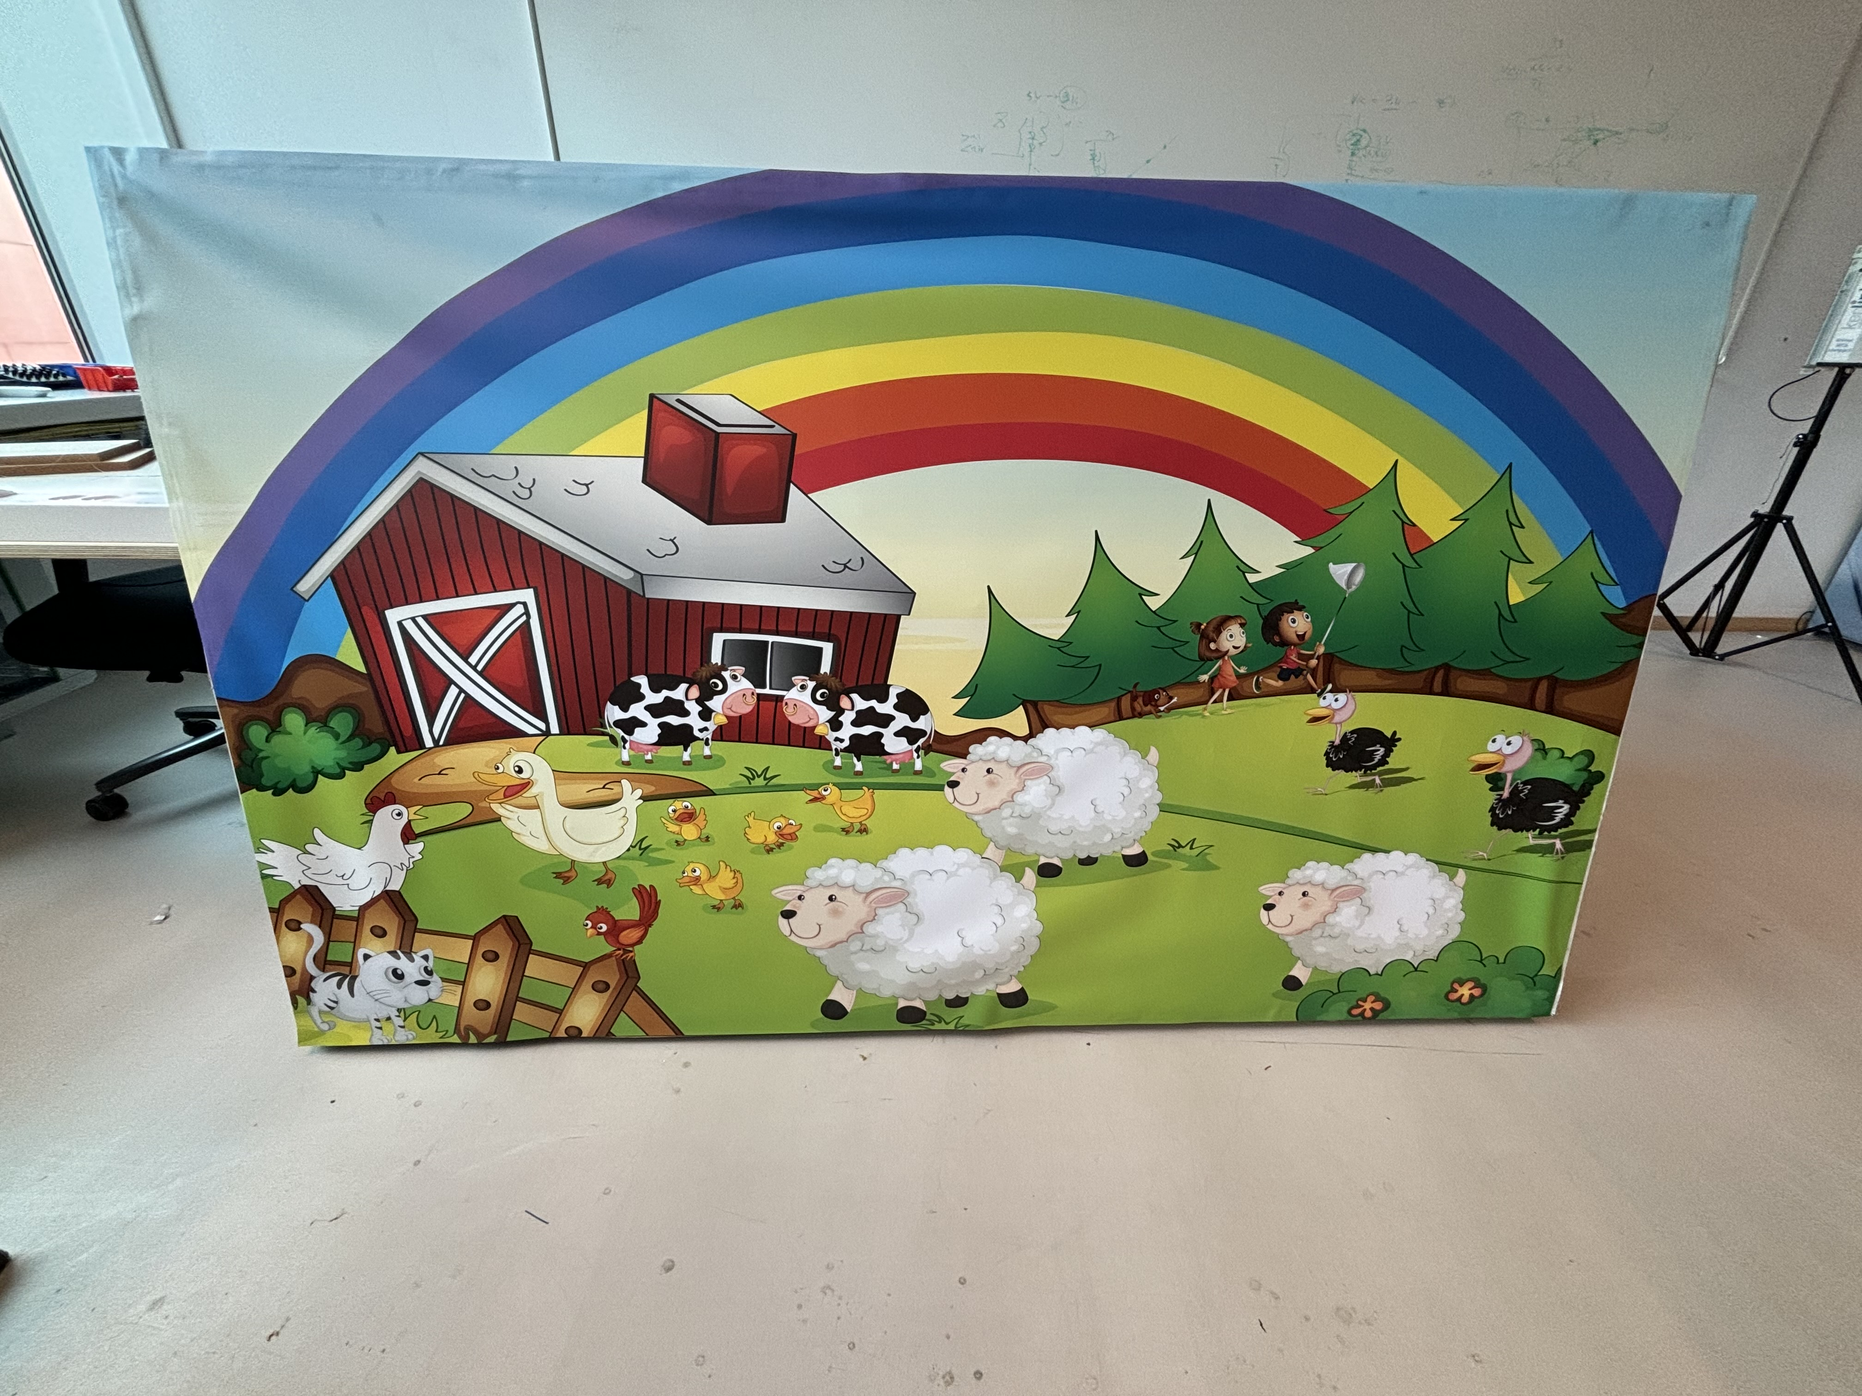

7. Results
The outcome
7. Results

Slide 13
8. Future Improvements
What could we do beter?
- Adding light effect (visual feedback)
- Cover for the back
-Play sounds
8. Future Improbements

Slide 14
Interactive Wall
Project Exprerience 2.2 International

